Slide 1
Deep neural network for XPS data analysis
제일원리 전자구조계산 연구실
박형선
강원대학교 물리학과 박 형 선
Kangwon National University Department of Physics 양자시공간 연구실

Slide 2
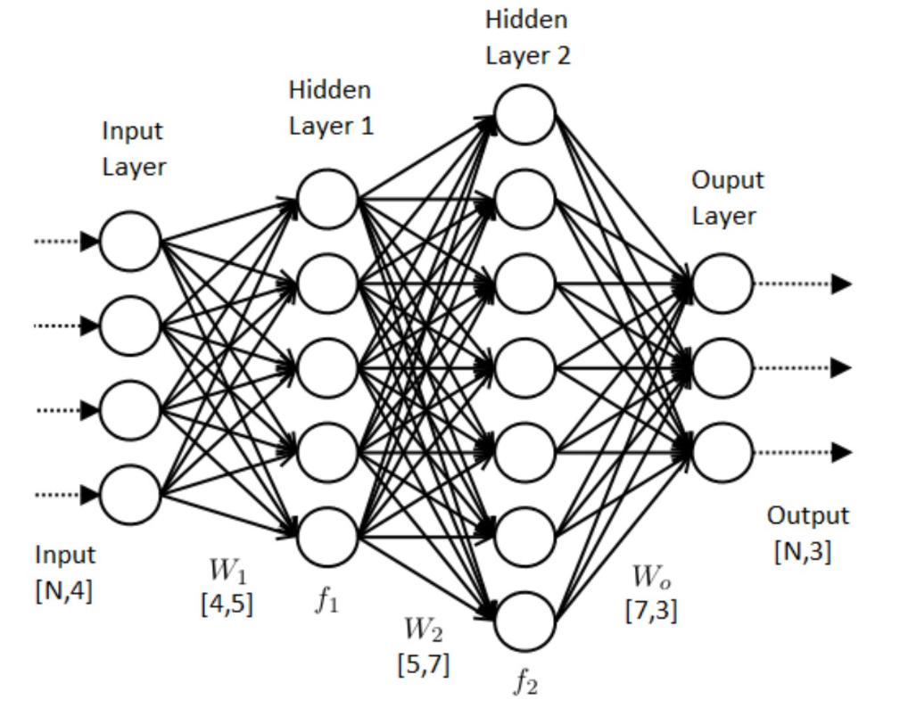
1. Artificial Neural Network
Consist of Artificial neuron and edge
One artificial neuron is originated from single perceptron
강원대학교 물리학과 박 형 선
Kangwon National University Department of Physics 양자시공간 연구실

Slide 3
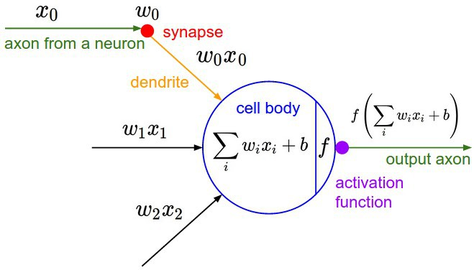
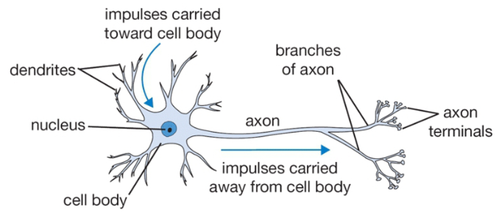
2. Single Perceptron
Sing Perceptron architecture
Input data -> linear combination -> Activation function -> Output
강원대학교 물리학과 박 형 선
Kangwon National University Department of Physics 양자시공간 연구실

Slide 4
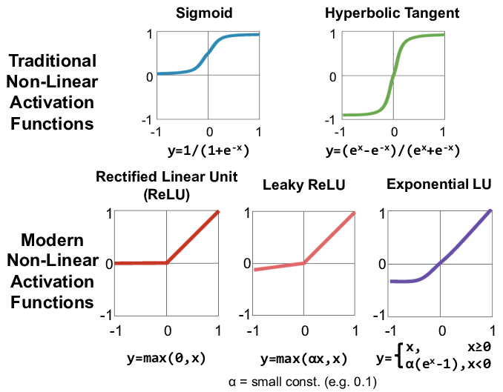
3. Activation functions
Activation functions are, generally well tabulated
Sigmoid : classification
Tangent Hyperbolic : GAN
Relu – hidden layer
강원대학교 물리학과 박 형 선
Kangwon National University Department of Physics 양자시공간 연구실

Slide 5
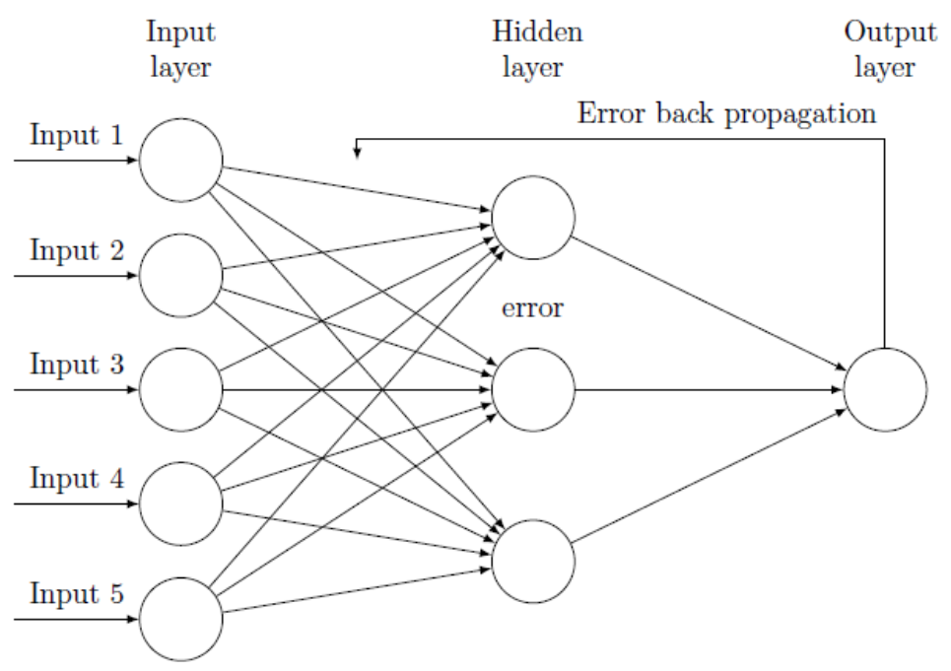
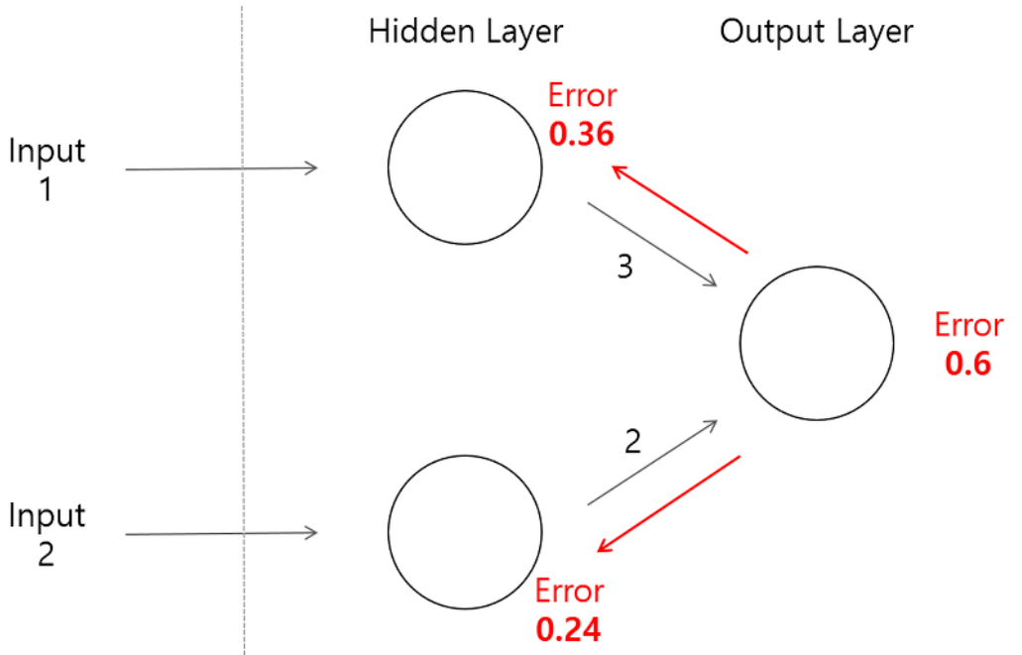
4. Backpropagation
Error = y_true – y_predict
Backpropagation to former layer
강원대학교 물리학과 박 형 선
Kangwon National University Department of Physics 양자시공간 연구실

Slide 6
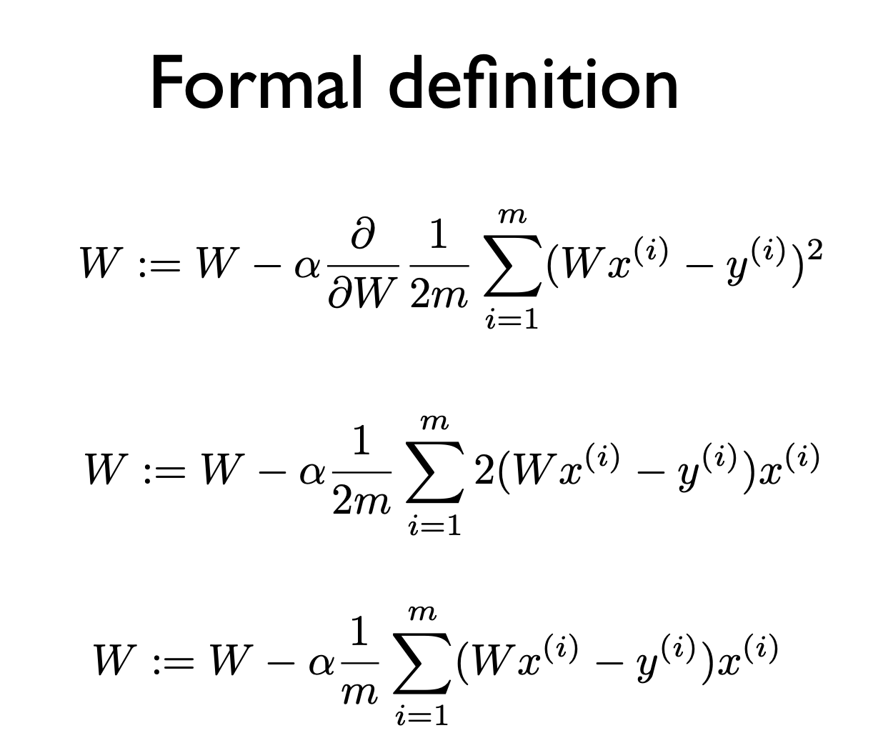
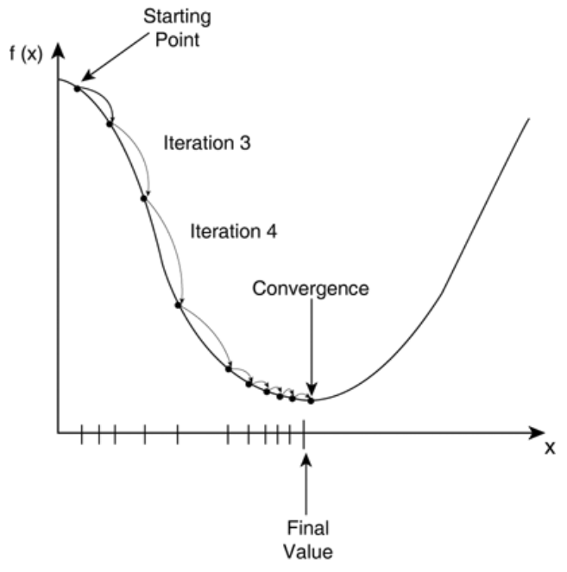
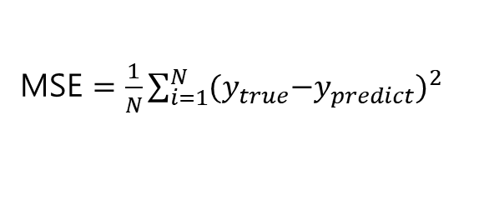
4. Backpropagation – Gradient Descent
MSE $=\frac{1}{N}\sum_{i=1}^{N}{{{(y}_{true}−y_{predict})}^{2}}$
Calculation of Gradient
Alpha : learning rate, hyper-parameter
강원대학교 물리학과 박 형 선
Kangwon National University Department of Physics 양자시공간 연구실

Slide 7
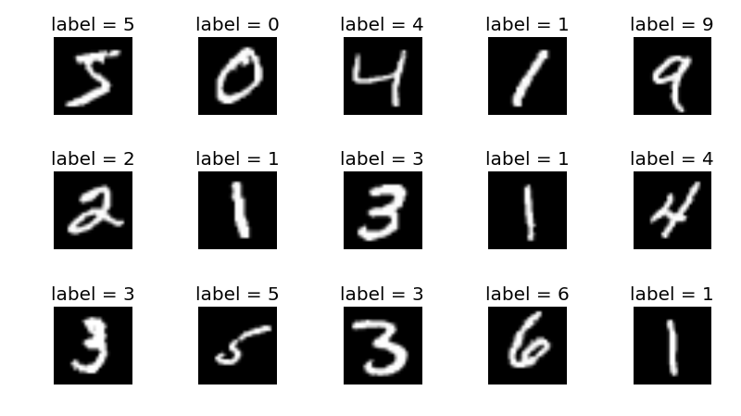
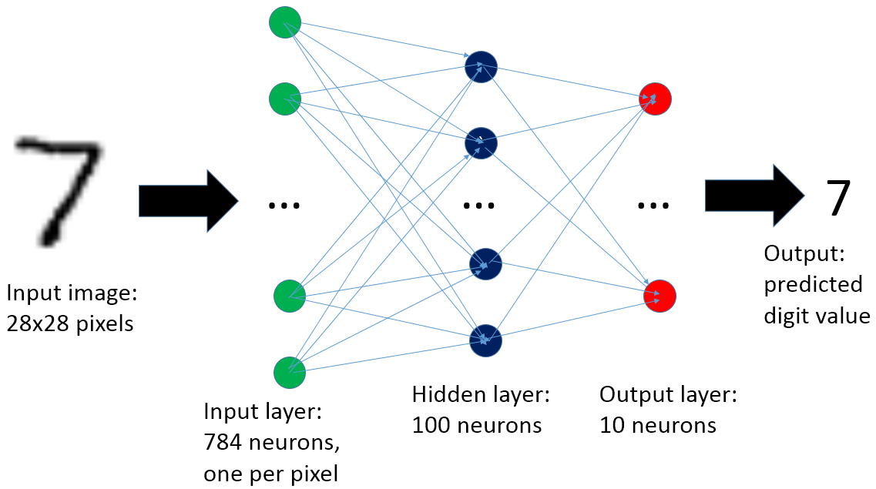
5. MNIST
Classification example
Handwritten digit picture with labeling(One-hot vector)
Input : image, output : label
강원대학교 물리학과 박 형 선
Kangwon National University Department of Physics 양자시공간 연구실

Slide 8
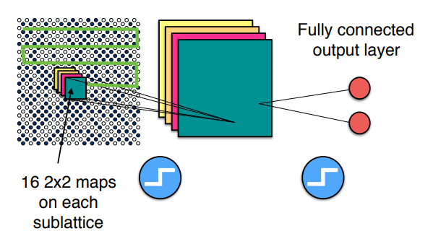
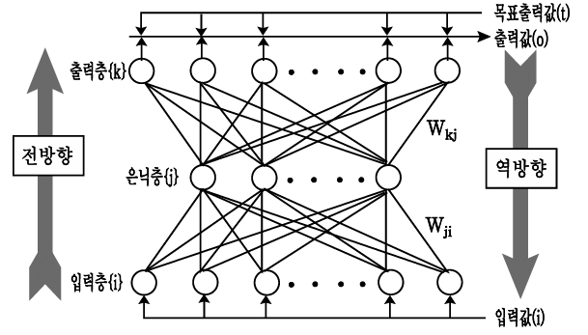
6. CNN(Convolutional Neural Network)
SGD
Weight update
Linear output
Activation function
Step1 : Feature extraction
Step2 : Neural network
Artificial Neural Network : Input layer + hidden layer + output layer
Direction : forward propagation, back propagation
강원대학교 물리학과 박 형 선
Kangwon National University Department of Physics 양자시공간 연구실

Slide 9
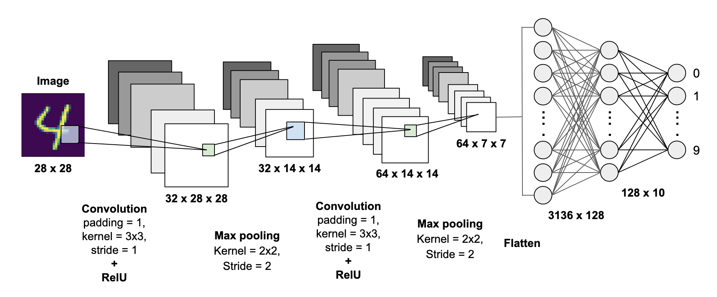
General CNN architecture
General CNN architecture
Input[image] -> Conv2D -> Pooling -> Conv2D -> Pooling -> … -> FCL -> … -> output[label]
강원대학교 물리학과 박 형 선
Kangwon National University Department of Physics 양자시공간 연구실

Slide 10
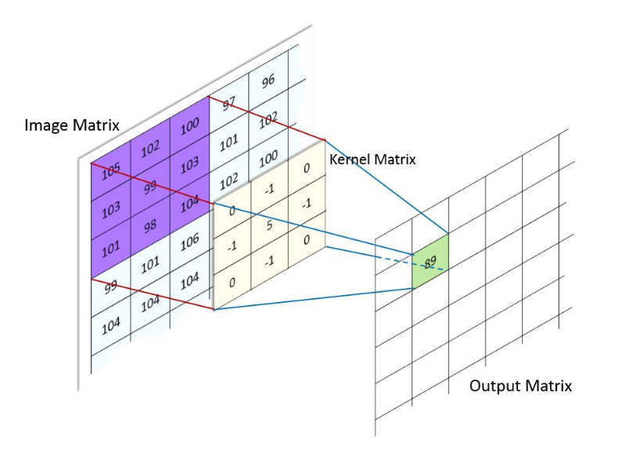
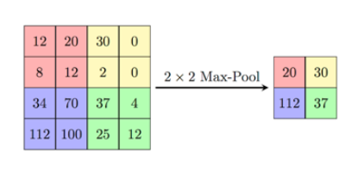
Convolution and Pooling
Convolution : Feature extraction using Kernel Matrix(filter)
(Max)Pooling : Sub-sampling, Feature compression
강원대학교 물리학과 박 형 선
Kangwon National University Department of Physics 양자시공간 연구실

Slide 11
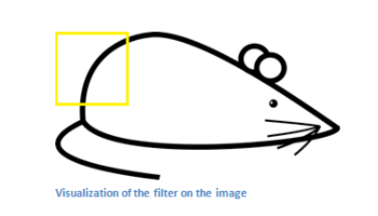
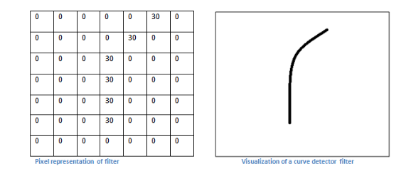
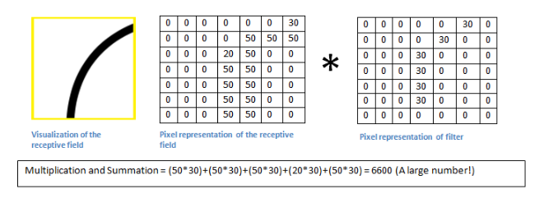
Convolution
Large value of convolution shows an existence of specific feature on the local area
강원대학교 물리학과 박 형 선
Kangwon National University Department of Physics 양자시공간 연구실

Slide 12
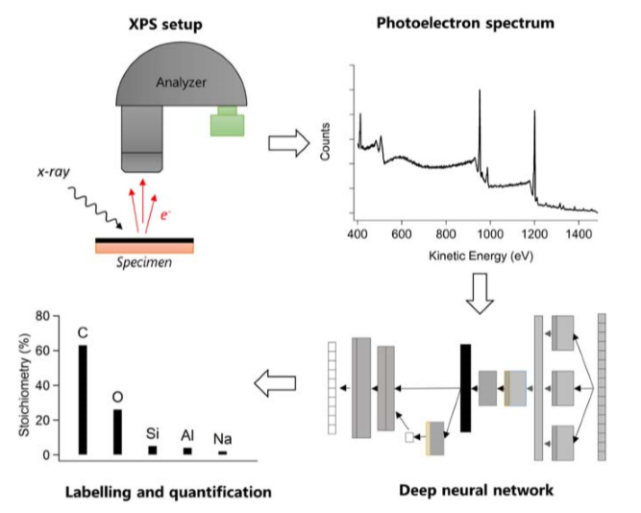
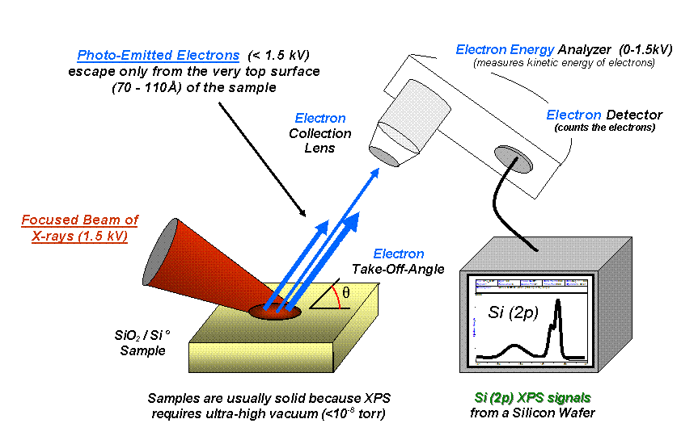
7. XPS Data Analysis
DCNN to detect and quantify chemical elements in experimental XPS data
XPS : Surface sensitive technique providing element analysis of topmost 10nm layer
강원대학교 물리학과 박 형 선
Kangwon National University Department of Physics 양자시공간 연구실

Slide 13
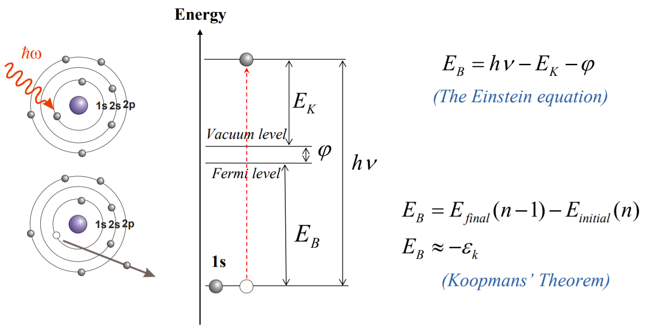
Basic Principle
강원대학교 물리학과 박 형 선
Kangwon National University Department of Physics 양자시공간 연구실

Slide 14
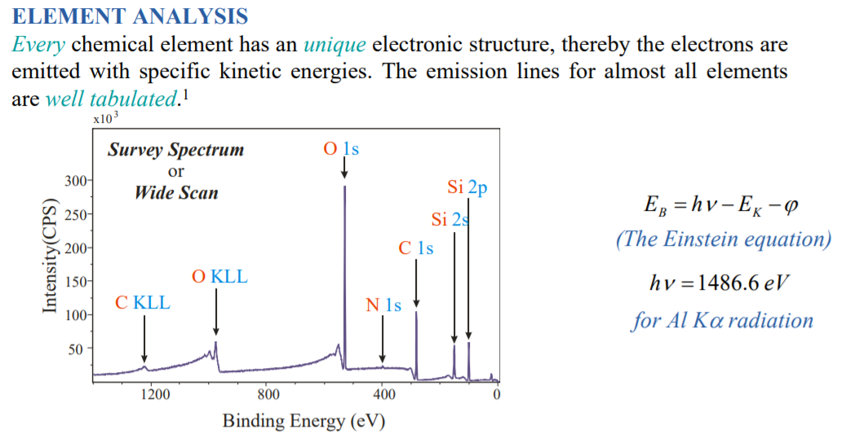
XPS Data
Experimental device using Photoelectric effect to get B.E. of electrons
강원대학교 물리학과 박 형 선
Kangwon National University Department of Physics 양자시공간 연구실

Slide 15
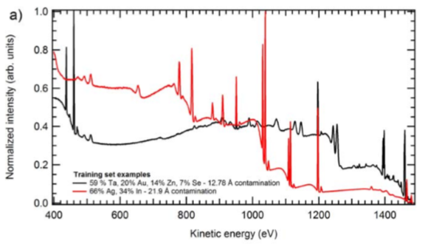
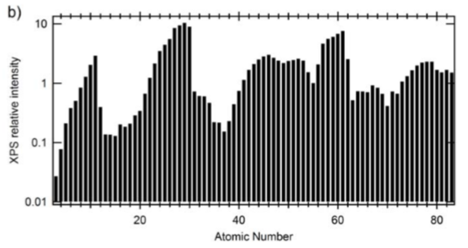
Figure 2. Synthetic Spectra data
(a) : An excerpt of two simulated survey training spectra
(b) : Maximum XPS intensity of simulated spectra for each pure element,
calculated for a fixed photon fulx,
photon energy = 1486.6eV, K.E. spectra range = 400 ~ 1486eV
강원대학교 물리학과 박 형 선
Kangwon National University Department of Physics 양자시공간 연구실

Slide 16
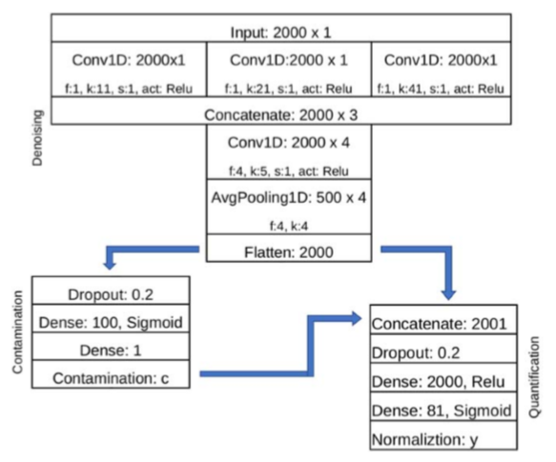

Figure 3. Deep neural network layout
Inception module version 4
f : the filter number, k : convolution kernel size, s : stride length
Total trainable parameters : 4366410
강원대학교 물리학과 박 형 선
Kangwon National University Department of Physics 양자시공간 연구실

Slide 17
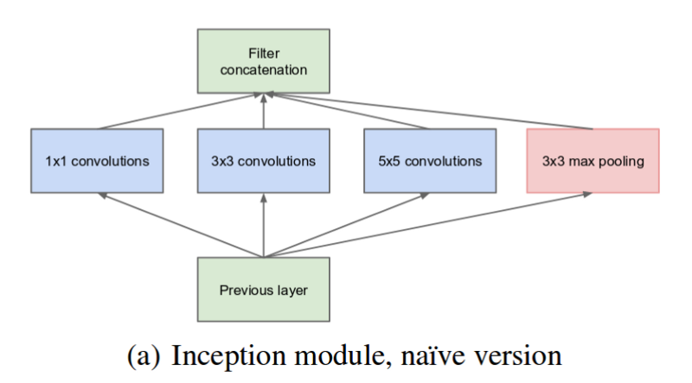
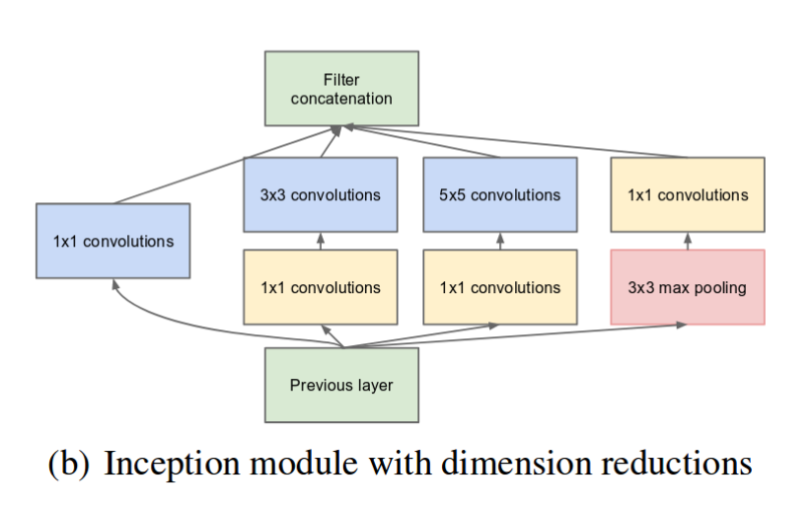
Inception Module
Inception module (in GoogLeNet) at ILSVRC 14
Parallel operation of convolution filter
Sparse Connectivity architecture <-> CNN FCL(dense layer)
강원대학교 물리학과 박 형 선
Kangwon National University Department of Physics 양자시공간 연구실

Slide 18
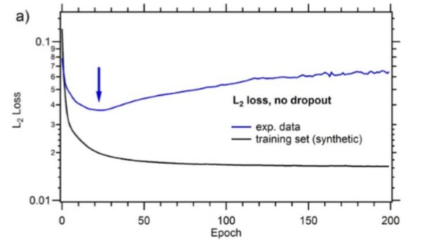
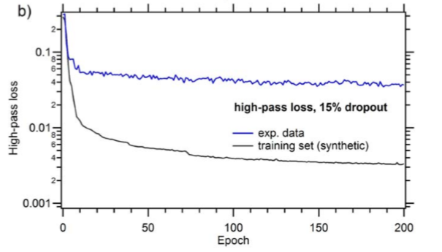
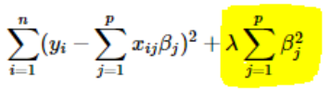
Figure 4. Loss function convergence in training
Case with “No dropout, and standard L2(Ridge) norm (over-fitting)
Case with a 15% dropout before classification layer, and high-pass norm optimizal p range = 0.1 ~ 0.2
강원대학교 물리학과 박 형 선
Kangwon National University Department of Physics 양자시공간 연구실

Slide 19
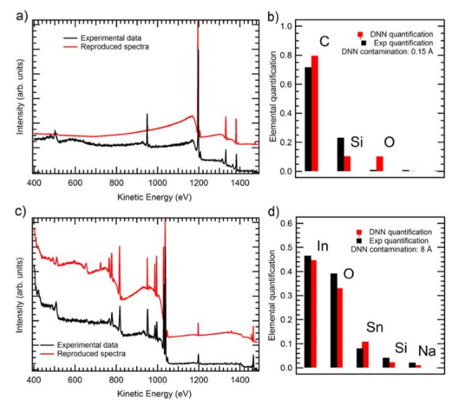
Result.
Application examples on two experimental sets; spectra(a) and quantification(b)
for carbon nanotubes on SI; spectra(c) and
quantification (d) for indium-tin oxide(ITO) deposited on Si.
For ITO case, the adventitious carbon contamination was factored out from the experimental quantification
강원대학교 물리학과 박 형 선
Kangwon National University Department of Physics 양자시공간 연구실

Slide 20
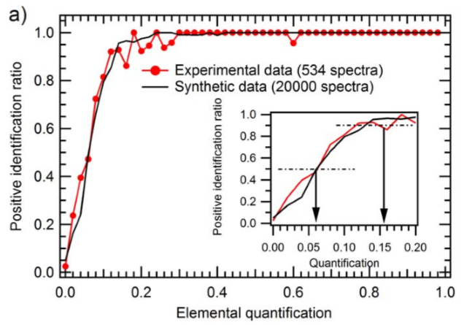
Result. Positive identification ratio
Positive identification ratio of DNN versus the quantification output :
calculated for the experimental data(red) and a synthetic training set(black)
강원대학교 물리학과 박 형 선
Kangwon National University Department of Physics 양자시공간 연구실

Slide 21
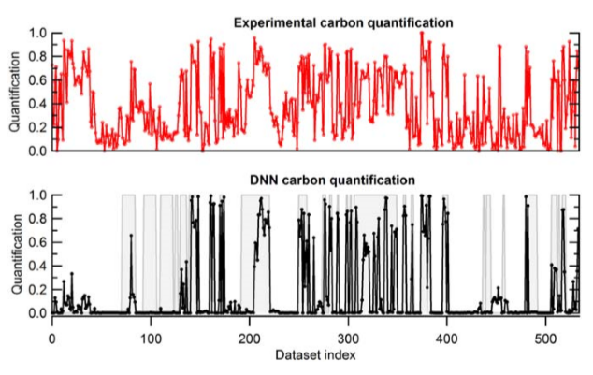
Result. Carbon quantization
Full carbon experimental quantification(red) and corresponding results for the DNN(black)
It has been trained to ignore carbon from adventitious contamination
강원대학교 물리학과 박 형 선
Kangwon National University Department of Physics 양자시공간 연구실

Slide 22
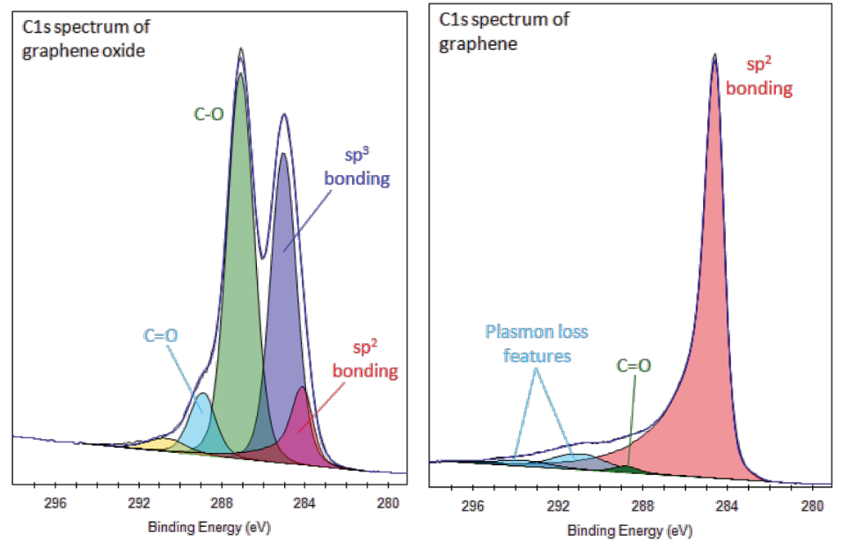
Peak Detection and Fitting
Objective : Automation of Peak fitting using machine learning
Useful features : number of peak, mean position, FWHM, intensity, area etc
강원대학교 물리학과 박 형 선
Kangwon National University Department of Physics 양자시공간 연구실

Slide 23
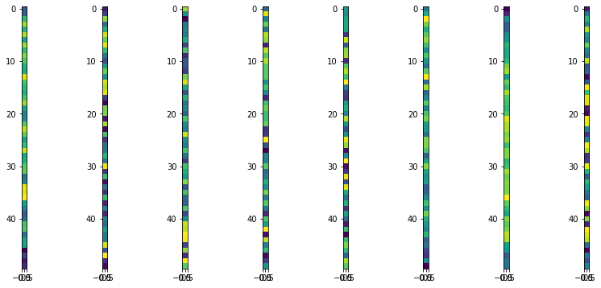
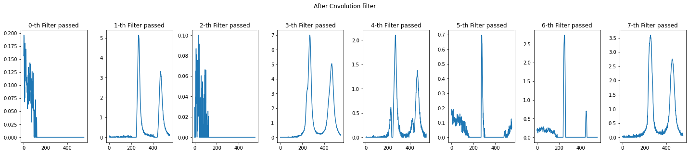
Filter visualization and convolution result
강원대학교 물리학과 박 형 선
Kangwon National University Department of Physics 양자시공간 연구실

Slide 24
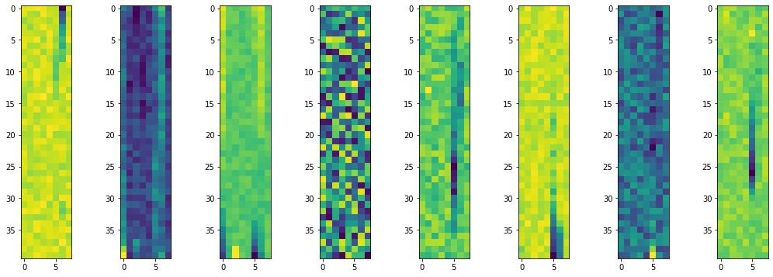
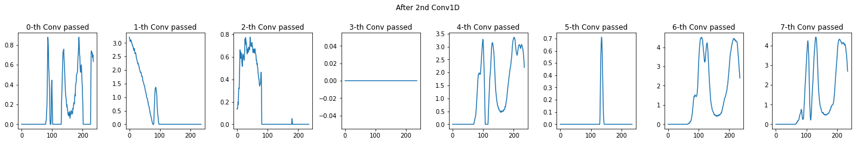
Filter visualization and convolution result
강원대학교 물리학과 박 형 선
Kangwon National University Department of Physics 양자시공간 연구실

Slide 25
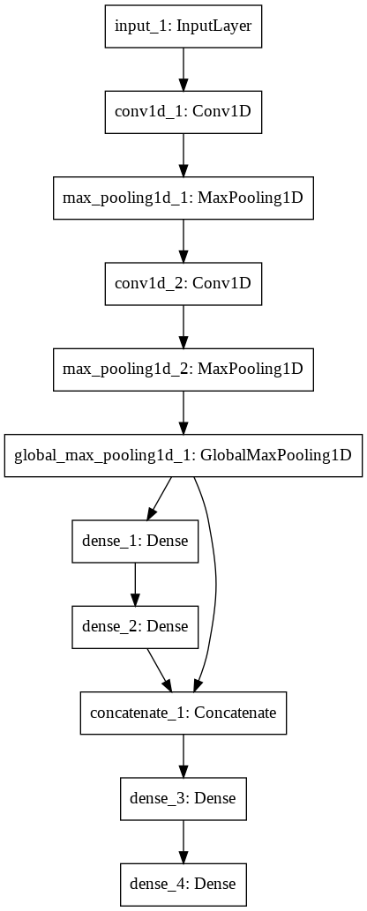
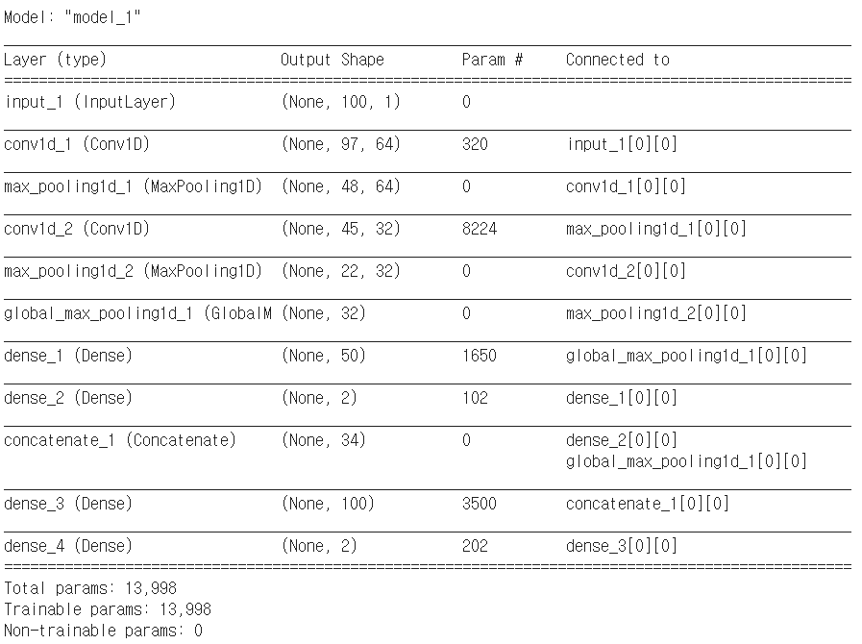
Peak Detection and Fitting
One input, two ouput
강원대학교 물리학과 박 형 선
Kangwon National University Department of Physics 양자시공간 연구실

Slide 26
감사합니다
Reference : Deep nerual network for x-ray photoelectron spectroscopy data analysis
강원대학교 물리학과 박 형 선
Kangwon National University Department of Physics 양자시공간 연구실

